Slide 1
The First People of Canada
Native Studies 120

Slide 2
The First North Americans
There are 4 theories on how the first people of North America came to be:
The Bering Straight Land Bridge
Crossing the Atlantic Ocean
Crossing the Pacific Ocean from South America
Creation Stories

Slide 3
The Bering Straight Land Bridge Theory
During the last Ice Age, some bodies of water froze, causing sea levels to drop and exposing land (the ocean floor).
In some cases, “Land Bridges” connected what are now seperate continents.

Slide 4
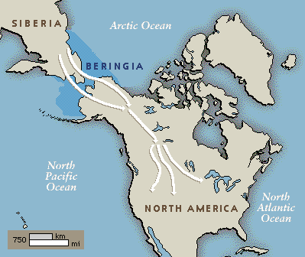
There is a body of water that separates Alaska and Siberia called “The Bering Strait.”

Slide 5
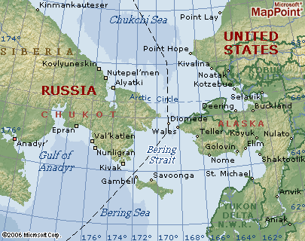
Map of Bering Strait

Slide 6
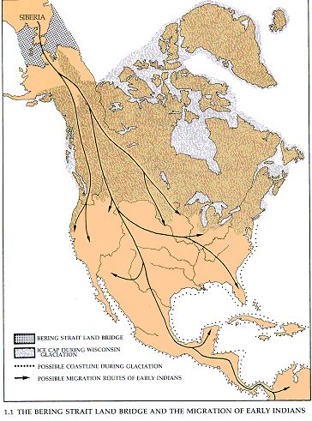

Slide 7
Migration
Scientists believe that both people and animals crossed this “Land Bridge.”
There is a theory that, in some cases, people and animals did not even know that they were entering a new continent.

Slide 8
After the Cold
After the Ice Age, there was massive melting period, causing the sea level to rise again and therefore separate – once again – Asia and North America.
People and animals were now living on a separate continent and were not even aware.

Slide 9
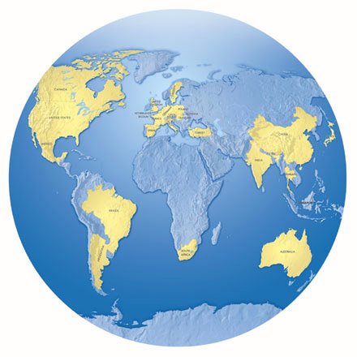
2. Crossing the Atlantic Ocean
The second theory on how North America’s first people arrived here is that they crossed the Atlantic Ocean, either on foot via ice, or by boat.

Slide 10
This theory is a new one, and often disputed.
We will watch the film “Ice Age Columbus,” which depicts what is might have been like for people to make this journey.

Slide 11
3.the Pacific Ocean routes northward
The Clovis First theory believes that the First Peoples originally migrated from the south near Clovis, New Mexico and other southern areas
This theory looks at the tools and similar beliefs among Indigenous cultures and hypothesizes that Indigenous cultures slowly migrated north along the Pacific coast and the interior.

Slide 12
4. Creation Stories
Traditionally, Aboriginal peoples of North America had their own “theories” on how their people cam to be on this land.
These were not “theories” at all, but Creation Stories that told how the world, and all living beings came to be.
Traditionally, Aboriginal People believed these to be true accounts, not “just stories or legends.”

Slide 13
Which is “Right” ?
There is no “right” explanation for how, or when Canada’s First People came to be.
The only right way to approach this topic is through RESPECT.
When discussing Canada’s First Nations, you must discuss and acknowledge the importance of Creation Stories to this culture and how they traditionally explain the creation of the world.

